Slide 1
Problem Solving (Number Theory)
Srivaths P

Slide 2
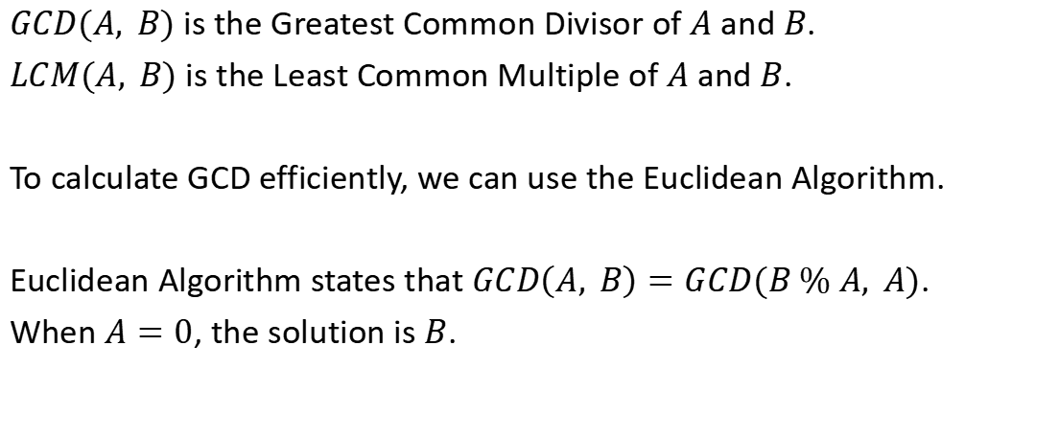
Greatest Common Divisor

Slide 3
Euclidean Algorithm – Code
Recursive:
Iterative:
int gcd_(int a, int b) { if (a == 0) return b; return gcd_(b%a, a); }
int gcd_(int a, int b) { while (a) { int t = a; a = b % a; b = t; }
return b; }

Slide 4
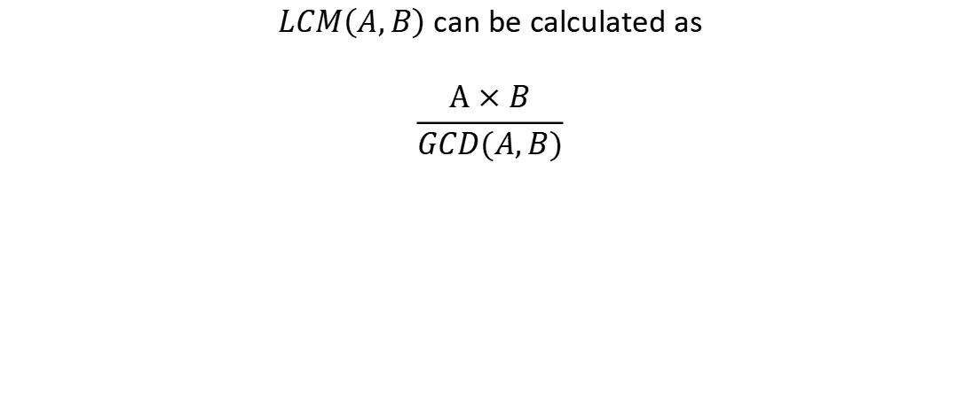
Least Common Multiple

Slide 5
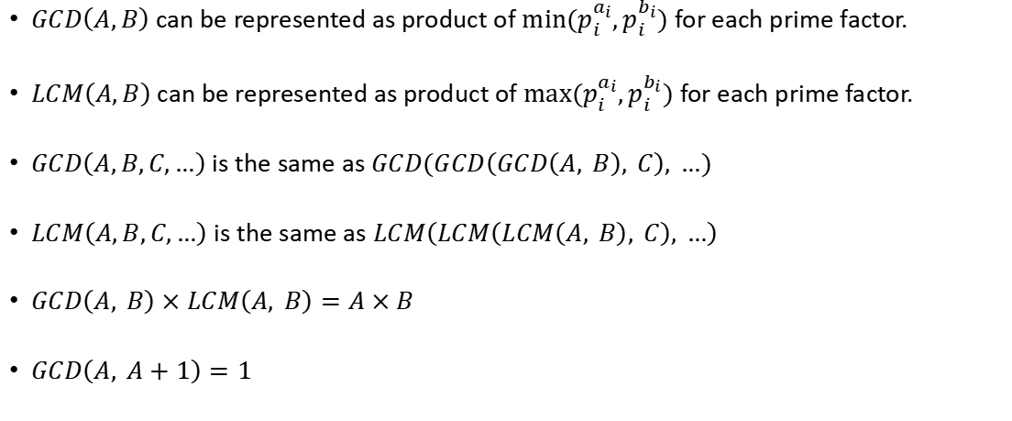
Properties of GCD / LCM

Slide 6
OEIS - Online Encyclopedia of Integer Sequences
Link: https://oeis.org/
OEIS can be used to find the formula of an integer sequence with just the first few values (which could be computed using brute-force or manually by hand).

Slide 7
Problem Solving
https://cses.fi/problemset/task/1712
https://cses.fi/problemset/task/1081
https://codeforces.com/problemset/problem/1474/B
https://codeforces.com/problemset/problem/1471/A
https://codeforces.com/problemset/problem/1617/B

Slide 8
Thanks for Watching!
Feedback form: https://docs.google.com/forms/d/e/1FAIpQLSdgV2lscu_LaXe1-mobccTZ4ooeVkIsa6G08hqf-tEfLUx1CA/viewform

